Slide 1
Computer Science
Predicate Logic
Samuel Lukas

Slide 2
Introduction
Predicate Logic allows us to manipulate statements about all or some things.
Example: the statement “all men are mortal”
It is represented as:
“For all x, if x is a man then x is mortal”
∀x (P(x)→Q(x))
“x” as a variable
Predicate : P “is a man” and Q is mortal
Propositional function P(x): “x is a man”
Propositional function Q(x): “x is mortal”

Slide 3
Example 01
Propositional function P(x): “x is a man”
P(jimmy) : jimmy is a man
Propositional function Q(x) : “is greater than 3”
Q(4) : 4 is greater than 3
Propositional function R(x, y) : “x = y + 3”.
R(1,2) : 1 = 2 + 3

Slide 4
Example 02
S(x) : x is a student in this class.
G(x) : x has studied calculus.
What does ∀x (S(x) → G(x)) mean ?
“If x is a student in this class, then x has studied calculus.”
or
“Every student in this class has studied calculus.”
The universe of discourse is the set of all students.

Slide 5
Example 3
P(x): x is a professor.
G(x): x is a genius.
What does ∃x (P(x) ∧ G(x)) mean ?
“There is an x such that x is a professor and x is a genius.”
or
“At least one professor is a genius.”

Slide 6
Combining Quantifiers
∀x∃y (x + y = 320)
Meaning:
“For every x there exists a y so that x + y = 320.”
Is it true for integer x,y ?
yes

Slide 7





Negating Quantified Expressions
$$\overline{∀xP\left(x\right)}=∃x\overline{P(x)}$$
$$∀xP\left(x\right)$$
“Every student in the class has taken a course in calculus”
$$\overline{∀xP\left(x\right)}$$
“There is a student in the class who has not taken a course in calculus”
$$∃x\overline{P(x)}$$
$$\overline{∃xP\left(x\right)}=∀x\overline{P(x)}$$

Slide 8
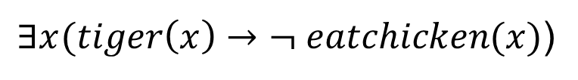
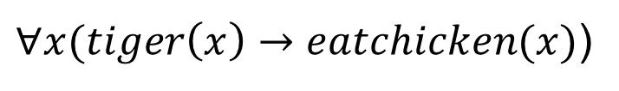
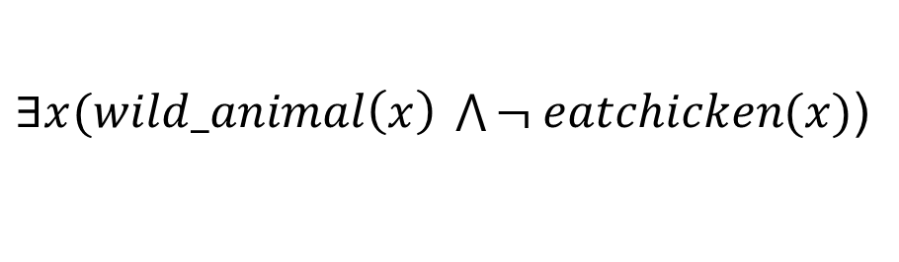
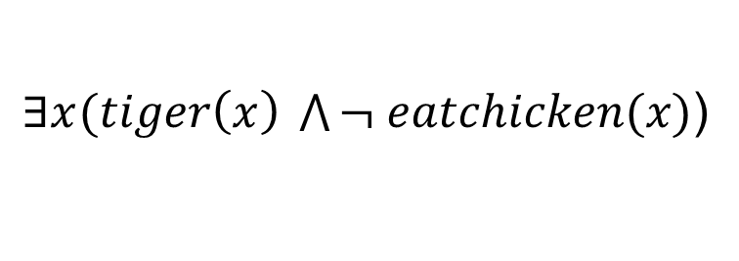
Example 04
Every tiger eats chicken
$∀x(tiger\left(x\right)→eatchicken(x)$)
Some tiger do not eat chicken
$∃x(tiger\left(x\right)→¬ eatchicken(x)$)
This is not correct
But
$∃x(tiger\left(x\right) \bigwedge{¬ eatchicken(x)}$)
Some wild animal do not eat chicken
$∃x(wild_animal\left(x\right) \bigwedge{¬ eatchicken(x)}$)

Slide 9
Example 05
Find the value of the predicate logic $∀x∃y,P\left(x,y\right): x,y∈\{1,2\}$
Given this table
P(1,1) | P(1,2) | P(2,1) | P(2,2)
True | False | False | True

Slide 10

Example 06
If domain of $x=\{1,2\}$ and domain of $a=\{1\}$
Find value $∃xp\left(f\left(x\right)\right)⋀q\left(x,f\left(a\right)\right)$ given true table below :
p(1) | p(2) | q(1,1) | q(1,2) | q(2,1) | q(2,2) | f(1) | f(2)
F | T | T | T | F | T | 2 | 1
If $x=1$ then $p\left(f\left(1\right)\right)⋀q\left(1,f\left(1\right)\right)≡p(2)∧q(1,2)≡True$
$$∴∃xp\left(f\left(x\right)\right)⋀q\left(x,f\left(a\right)\right)=True$$

Slide 11
Inference Predicate Logic example

Slide 12
Prenex Normal Form (PNF)

Slide 13
Formulas for Prenex Normal form

Slide 14
Example 06

